Slide 1
Data Presentation
Marketing Analytics Portfolio Project

Slide 2
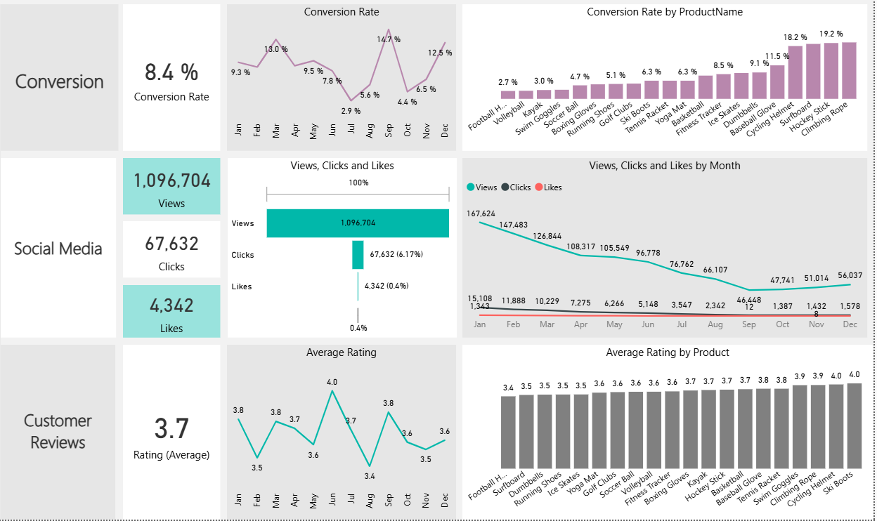
Overview - 2025 Marketing Performance
Conversion Rates
For much of the year these have been < 10%, which requires improvement
Recommend investigate route causes of seasonality highlighted in decline spring through summer and pick up in winter months
Autumn looks anomalous, why 10% drop from Sep to Oct, investigate further
Customer Engagement
Decline in overall social media engagement, with views dropping throughout the year
Click-through rate stands at 6.17%, particularly concerning
Customer Feedback
Customer ratings relatively consistent, averaging around 3.7 throughout the year.
The average rating below 4.0 target
Need focused improvements in customer satisfaction

Slide 3
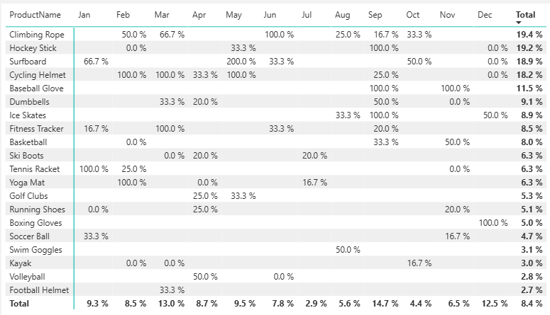
Conversion Rates
General Conversion Trend
Conversation rate highly variable, ranging 2.9% (Jul) – 14.7% (Sep)
There is seasonality, September peak could indicate sales due to new school year and December peak relate to Christmas
March peak less obvious and worth further analysis
Lowest Conversion Rates
July 2.9% - needs investigating to avoid repeat in the coming year
Recommend pre-summer campaign focused on key summer and holiday products with attractive pricing and multiple product offers
Review low performing products e.g. football helmet and volleyball, why are these unattractive, is it price, perceived quality, unattractive design, low general market demand?
Highest Conversion Rates
September 14.7% - the return to school sales a strong area to further capitalize on
Is the May 200% conversation rate for Surfboard linked to any marketing activity appears anomalous recommend further analysis

Slide 4
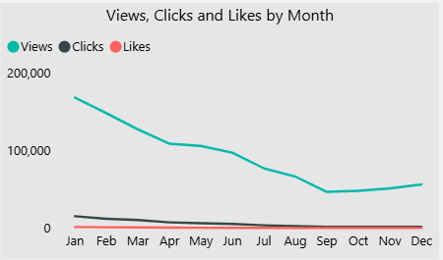
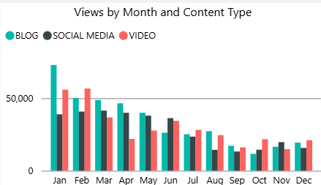
Reduced Customer Engagement
Views
Big decline from January through August
Minor recovery September onwards
Interaction Rates
Clicks and likes remained consistently low compared to views, highlighting need for more engaging content and stronger calls to action
Content Type Performance
Blog content particularly strong in January but it’s influence relative to other content decreased thereafter
No consistent pattern in the most influential content type
Some tendency towards a more equally proportional split in Q4

Slide 5
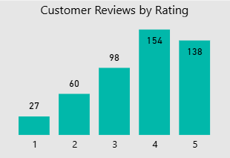
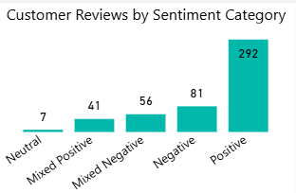
Customer Feedback Analysis
Customer Ratings Distribution
Most customer reviews are in the higher ratings, with 154 reviews at 4 stars and 138 reviews at 5 stars, indicating overall positive feedback. Lower ratings (1-2 stars) account for a smaller proportion, with 27 reviews at 1 star and 60 reviews at 2 stars
Sentiment Analysis
Positive sentiment dominates with 292 reviews, reflecting a generally satisfied customer base. Negative sentiment is present in 81 reviews, with a smaller number of mixed and neutral sentiments, suggesting some areas for improvement but overall strong customer approval
Opportunity for Improvement
The presence of mixed positive and mixed negative sentiments suggests that there are opportunities to convert those mixed experiences into more clearly positive ones, potentially boosting overall ratings. Addressing the specific concerns in mixed reviews could elevate customer satisfaction

Slide 6
Goals and Actions
Goals
Actions
Increase Conversion Rates
Goal: Identify factors impacting the conversion rate and provide recommendations to improve it
Insight: Highlight key stages where visitors drop off and suggest improvements to optimize the conversion funnel
Enhance Customer Engagement
Goal: Determine which types of content drive the highest engagement.
Insight: Analyze interaction levels with different types of marketing content to inform better content strategies
Improve Customer Feedback Scores
Goal: Understand common themes in customer reviews and provide actionable insights
Insight: Identify recurring positive and negative feedback to guide product and service improvements
Increase Conversion Rates
Target High-Performing Product Categories: Focus marketing efforts on products with demonstrated high conversion rates, such as Climbing Rope, Surfboard, Hockey Stick and Cycling Helmet. Implement seasonal promotions or personalized campaigns during peak months (e.g. December and September) to capitalize on these trends
Enhance Customer Engagement
Revitalize Content Strategy: To turn around declining views and low interaction rates, experiment with more engaging content formats, such as interactive videos or user-generated content. Additionally, boost engagement by optimizing call-to-action placement in social media and blog content
Improve Customer Feedback Scores
Address Mixed and Negative Feedback: Implement a feedback loop where mixed and negative reviews are analyzed to identify common issues. Develop improvement plans to address these concerns. Consider following up with dissatisfied customers to resolve issues and encourage re-rating, aiming to move average ratings closer to the 4.0 target

